Slide 1


Differential relatedness of African Americans to populations within West Africa
Katarzyna Bryc*, Amy L. Williams*, Yiqi Huang*, Nick Patterson, Solomon Musani, Michele Sale, Wei-Min Chen, Jasmin Divers, Maggie C. Ng, Donald W. Bowden, James G. Wilson, David Reich
Amy L. Williams
Yiqi Huang
Poster: 1662T (3:15PM-4:15PM on Thu)
Notes:
Thanks to the ASHG program committee for allowing me to speak today, as well as to trust my punctuality by having me serve as co-moderator at this session. To begin, joint effort of many people, but especially Amy Williams who spearheaded IBD analysis, and Yiqi Huang who has a manuscript in prep studying a unique afam pop called the Gullah population, that I will get to tell you a little bit about today. Shameless plug
----- Meeting Notes (11/7/12 12:03) -----
Admixture, or the mixing of populations with distinct ancestry, has been increasingly appreciated a strong force shaping human population structure across the world. Here in the US, it has direct relevance in understanding the ancestry of afams.

Slide 2
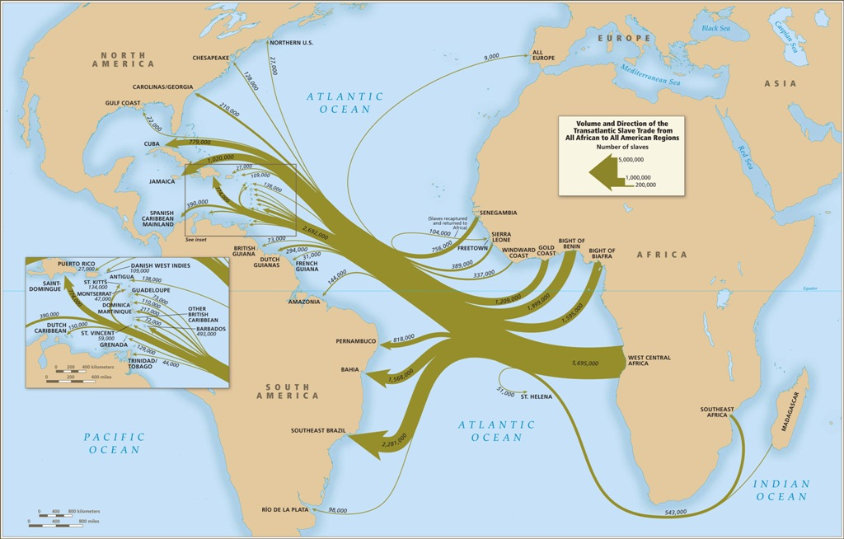
What we know from history about the Trans-Atlantic Slave Trade
From: Atlas of the Transatlantic Slave Trade, Eltis and Richardson, based on www.slavevoyages.org
Notes:
----- Meeting Notes (11/6/12 19:17) -----
Question of what the genetic ancestry is of afams in the US today.
----- Meeting Notes (11/7/12 12:03) -----
Historians have painstakingly investigated records of the trans atlantic slave trade that brought over about 500,000 afams from different regions of africa, into the US through different ports.

Slide 3
What we know from genetics
African ancestry primarily from West Africa
[Lovejoy 2000, Salas 2005, Price 2009, Tishkoff 2009]
Variation in African vs. European ancestry proportion
[Parra 1998, Parra 2001, Smith 2004, Lind 2007, Bryc 2010]
Evidence for sex-bias in ancestry contributions
[Parra 2001, Lind 2007, Bryc 2010]
Notes:
what we know from genetics about the African ancestry of African Americans

Slide 4
A simple model of admixture
t
G
Africa
African Americans
Europe

Slide 5
True admixture history more complex
Africa
African Americans
Europe

Slide 6
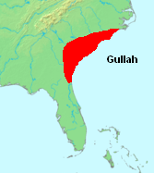
African American cohorts
Source | N | Cohort | Location
CARe | 2,933 | ARIC | Jackson, Winston Salem, Minneapolis, Baltimore
 | 955 | CARDIA | Birmingham, Chicago, Minneapolis, Oakland
 | 632 | CFS | Large family recruitment in Cleveland area
 | 2,134 | JHS | Jackson, Mississippi
 | 1,633 | MESA | NYC, Baltimore, Chicago, LA, Winston Salem, Twin Cities
COBRE, SUGAR | 1,449 | Gullah | South Carolina Sea Islands
Gullah – a unique African American population
Live in Lowcountry of South Carolina and Georgia
Speak Sea Island Creole language
linked to Krio of Sierra Leone
Cultural links to rice-growing regions of Africa
Notes:
JHS uniqueness
Geechee language
NHLBI Candidate gene Association Resource

Slide 7
African populations analyzed
Chadic
Far West Africa
West Africa
East Africa
Pygmy
Central Africa
Notes:
To limit the dimensionality of the models we explored, we considered the African populations with the following first approximation clusters

Slide 8
African populations analyzed
Gambia
n = 2,862
Sierra Leone
n = 400
Yoruba
n = 756

Slide 9
Ancestry estimates based on allele frequencies
Linear model like method
Statistical support for at least five populations contributing ancestry to African Americans:
Europe
West Africa
Far West Africa
Central Africa
Native American
Far West Africa
West Africa
Central Africa
QPMIX: Patterson et al. (2010) Human Molecular Genetics
Notes:
Model admixed population as a mixture of ancestral; framework for testing significance of additional components

Slide 10
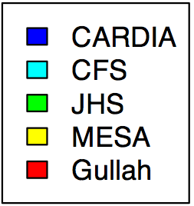
Ancestry estimates based on allele frequencies
Continental
~ 1.2%
Huang et al., in preparation

Slide 11
Ancestry estimates based on allele frequencies
Continental
Within-Africa
*
*
~ 1.2%
Gullah show different African ancestry composition
No significant differences among diverse African American groups (e.g., Mississippi vs Ohio)
Huang et al., in preparation

Slide 12
Inferring relatedness based on recently shared DNA segments
Identical-By-Descent (IBD): ≥ 3cM segments inherited without recombination from a common ancestor
African American
Gambia
Yoruba
Phasing via HAPI-UR Williams et al. (2012) AJHG
IBD via GERMLINE Gusev et al. (2008) Genome Research
Notes:
Won’t find ancestry from all segments, but enough across the genome
----- Meeting Notes (11/6/12 19:17) -----
limited to large populations

Slide 13
IBD reflects ancestry
IBD segments per pair
*
*
West Africa
Far West Africa
Notes:
these numbers are not ancestry, but relative proportions and proportional to relative ancestry
restricting IBD to the af pops with large sample sizes

Slide 14
Conclusions
No differences detected in the mixtures of African ancestry across most African American groups
Gullah have uniquely distinct ancestry
Future:
Between-individual ancestry differences?
Gene flows among African American communities?
Notes:
Within our resolution limits, c
More African American data from localized sources

Slide 15
Acknowledgements
Harvard Medical School/Broad Institute
David Reich
Amy L. Williams
Nick Patterson
Reich lab members
University of Mississippi Medical Center
Solomon Musani
James G. Wilson
University of Virginia, Charlottesville
Yiqi Huang
Michele Sale
Wei-Min Chen
Wake Forest University
Jasmin Divers
Maggie C. Ng
Donald W. Bowden
University of Alabama at Birmingham
W. Timothy Garvey, MD
Medical University of South Carolina
Jyotika Fernandes, MD
Amy L. Williams
Yiqi Huang
The many study participants that have made this work possible

Slide 16
Notes:
----- Meeting Notes (11/7/12 11:24) -----

Slide 17
African population names

Slide 18
African American cohorts
Source | Sample Size | Cohort | Location
CARe: The NHLBI Candidate gene Association Resource | 2,933 | ARIC: Atherosclerosis Risk in Communities | Four U.S. communities (Jackson, Winston Salem, Minneapolis, Baltimore)
 | 955 | CARDIA: Coronary Artery Risk Development in Young Adults | Four U.S. communities (Birmingham, Chicago, Minneapolis, Oakland)
 | 632 | CFS: Cleveland Family Study | Large family recruitment from probands in three Cleveland area hospitals
 | 2,134 | JHS: Jackson Heart Study | Urban and rural areas of Jackson, Mississippi
 | 1,633 | MESA: Multi-Ethnic Study of Atherosclerosis | Six clinics across the U.S. (New York, Baltimore, Chicago, LA, Winston Salem, Twin Cities)
COBRE, SUGAR | 1,449 | Gullah | South Carolina Sea Islands
Gullah – a unique African American population
Lowcountry of South Carolina and Georgia
Sea Island Creole language linked to Krio of Sierra Leone
Historical and cultural links to rice growing regions of Africa
Notes:
JHS uniqueness
Geechee language

Slide 19
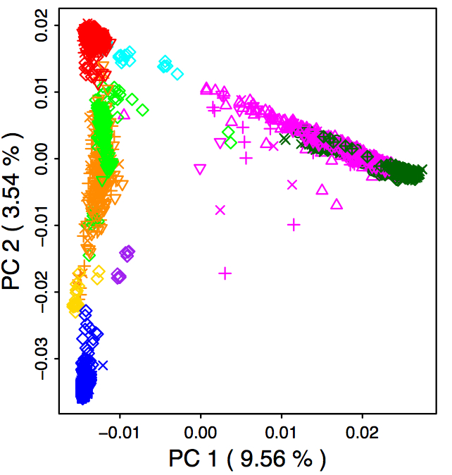
PCA shows no dataset artifacts
Merged multiple datasets
Affymetrix 6.0 and 500K arrays
255,029 SNPs
Europe
African Americans
Africa
Color - population
Shape - dataset
East Asia
Notes:
Strong data QC

Slide 20
ADMIXTURE
Native Americans
African Americans
Africans
Europeans

Slide 21
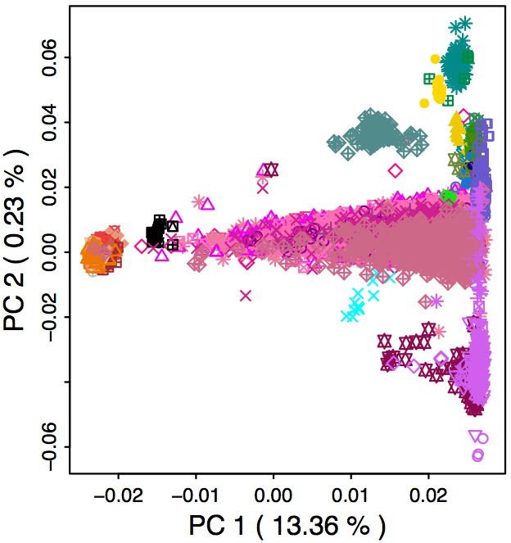
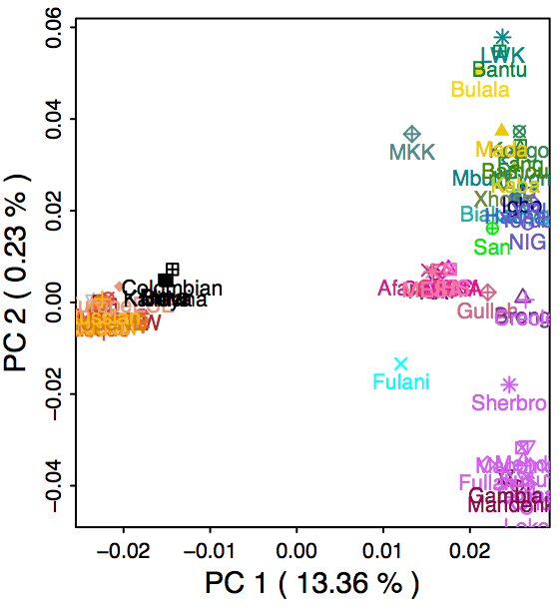
PCA
East Africa
Central Africa
West Africa
Europe
African Americans
Far West Africa

Slide 22
QPMIX
 | MESA | CFS | JHS | CARDIA | Gullah
Europe | 20.4% | 18.8% | 16.1% | 17.9% | 6.8%
WestAfrica | 38.3% | 38.9% | 39.4% | 38.2% | 36.5%
WestWestAfrica | 15.2% | 15.4% | 16.1% | 16.1% | 26.5%
Bantu | 25.0% | 25.7% | 27.3% | 26.5% | 28.9%
NorthAmerica | 1.2% | 1.2% | 1.1% | 1.2% | 1.4%
Non-African: | 21.600% | 20.000% | 17.200% | 19.100% | 8.200%
African ancestry components:
 | MESA | CFS | JHS | CARDIA | Gullah
WestAfrica | 48.9% | 48.6% | 47.6% | 47.2% | 39.8%
WestWestAfrica | 19.4% | 19.3% | 19.4% | 19.9% | 28.9%
Bantu | 31.9% | 32.1% | 33.0% | 32.8% | 31.5%

Slide 23
IBD sharing proportions
 | JHS | Gullah | ARIC | CARDIA | CFS | MESA | UCSF | EA
Gambia | 0.0285 | 0.0363 | 0.0271 | 0.0266 | 0.0265 | 0.025 | 0.0214 | 0.0018
LEONE | 0.0307 | 0.0404 | 0.0292 | 0.028 | 0.029 | 0.0286 | 0.023 | 0.0005
NIG | 0.0577 | 0.0543 | 0.0556 | 0.0536 | 0.0551 | 0.0552 | 0.0459 | 0.0002

Slide 24
Similarity among CARe cohorts
QPMIX
IBD
Far West Africa
West Africa
Estimated ancestry
Central Africa
 | MESA | CFS | JHS | CARDIA | Gullah
Europe | 20.4% | 18.8% | 16.1% | 17.9% | 6.8%
West Africa | 38.3% | 38.9% | 39.4% | 38.2% | 36.5%
West West Africa | 15.2% | 15.4% | 16.1% | 16.1% | 26.5%
Bantu | 25.0% | 25.7% | 27.3% | 26.5% | 28.9%
North America | 1.2% | 1.2% | 1.1% | 1.2% | 1.4%
Proportionately lower West African ancestry and higher WestWest African ancestry
Number of IBD segments per pair
 | MESA | CFS | JHS | CARDIA | Gullah
Yoruba | 0.055 | 0.055 | 0.058 | 0.054 | 0.054
Gambia | 0.025 | 0.027 | 0.029 | 0.027 | 0.036
Sierra Leone | 0.029 | 0.029 | 0.031 | 0.028 | 0.040
Huang et al., in preparation
Notes:
# IBD segments does not directly tell us the proportion of ancestry, however, the relative sharing among pairs again validates this pattern

Slide 25
Proxy ancestral populations
Continent | Source | n (post-QC) | Population(s)
Africa | Cooper et al. | 756 | NIG - Yoruba
 | SIERRA LEONE | 325 | Sierra Leone
 | WTCCC | 2,744 | Gambia
 | Bryc et al. | 139 | Hausa, Igbo, Brong, Kongo, Fulani, Bulala, Bamoun, Bantu, Xhosa, Fang
 | HapMap | 335 | YRI, MKK, LWK
 | HGDP | 20 | Yoruba, Mandenka, Biaka Pygmy, Mbuti Pygmy
Europe | POPRES | 2,341 | EuropeS, EuropeC, EuropeNW, ….
 | Cooper et al. | 1,169 | EA
 | HGDP | 35 | Adygei, French, Italian, Orcadian, Russian, Sardinian, Tuscan
Native Americans | HGDP | 25 | Pima, Surui, Colombian, Karitiana, Maya

Slide 26
IBD sharing by ancestry

Slide 27
Variable Native American ancestry

